Slide 1

Class 3

Slide 2
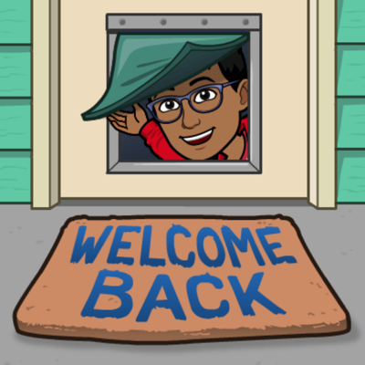
Welcome Again!

Slide 3


Today’s Schedule
Quick Apology
The stuff we learn at the beginning of today’s class have no connections to each other, because these are things that were supposed to be learnt last class. We didn’t have enough time.
Agenda:
Beginning of Class
Last Week Class Review
HW Pickouts
Let’s Learn - Variables
Let’s Learn - Casting
BREAK
Dive Deeper – Lists
Kahoot Time!
Practice Pickouts
HW Instructions
End of Class

Slide 4

Last Week – What did we learn?
Let’s discuss what we learnt last class.
Raise your hand to answer.

Slide 5


HW Pickouts
We will have 1 HW Pickout today. Afterwards I’ll open up my copy of what the HW should be in repl.it, IF people still have questions. If no-one volunteers to share their HW, I’ll just share my copy. (I actually don’t have a copy available today… so I’ll just code on the spot)

Slide 6
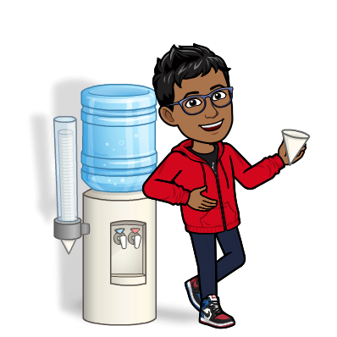
Let’s Learn - Variables
Now let’s learn about variables. These will help us store integers and string. It makes life easier in the field of python.
Variables are often found in algebraic equations, and multiple other coding languages.
There isn’t a definite set of categories for variables
This will probably be easier, once I open up repl.it.
Let’s go!
Let’s Learn – Printing and Commenting
Let’s Learn – Printing and Commenting

Slide 7

Let’s Learn - Casting
Now that we finally got around to learning about variables, let’s learn something a little similar to defining something. Expect it RE-defines something.
Let’s learn…. Casting!
Let me open repl.it! We can learn it!
And no… It’s not related to fishing.
Let’s Learn – Printing and Commenting
Let’s Learn – Printing and Commenting

Slide 8

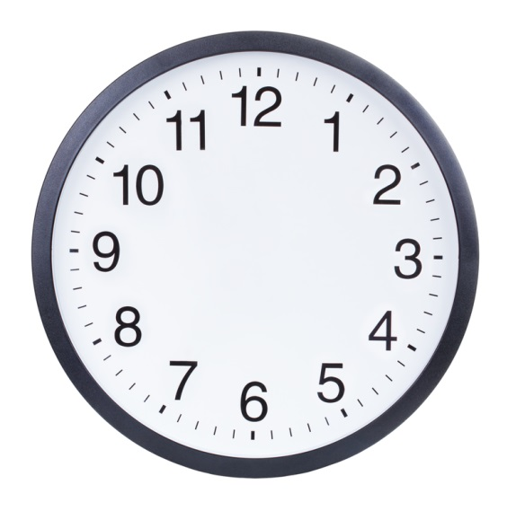
5 Minute Break!
5 minutes

Slide 9

Dive Deeper - Lists
Let’s now learn more about Lists, which will connect to datatypes like string and integer. We will also learn a bit about tuple.
Let’s learn!
Let’s Learn – Printing and Commenting
Let’s Learn – Printing and Commenting

Slide 10
Dive Deeper+

Slide 11




Practice Pickouts
Let’s practice what we learnt with some…. Practice Pickouts!

Slide 12

HW Info
Let me explain this week’s HW. I’ll go open it up!

Slide 13


Thanks for joining!

